Slide 1
Installing K8S
Sameer Zulfi

Slide 2
Ways to get the Kubernetes Cluster
Play with Kubernetes
Docker Desktop : Local development cluster on your Laptop
MiniKube : Local development cluster on your laptop
GKE : Google Kubernetes Engine : Production grade hosted cluster
EKS : AWS Elastic Kubernetes Service
Kubeadm : Manual Installation with kubeadm
Kubectl : The Kubernetes Command Line Tool

Slide 3
Hosted Kubernetes Service
Control Plane ( masters ) is managed by a 3rd party such as your cloud platform.
For Ex : AKS, EKS & GKE are all hosted Kuberenetes Services where management of the Control Plane is taken care of by the cloud platform.
Many companies are using hosted kubernetes platforms

Slide 4
Play with Kubernetes
It is free and greatway way to get your hands on a Kubernetes cluster without having to install anything.
Limitation is you will get a lab that lasts for 4 hours.
Please open http://play-with-k8s.com
Login with your Github or Dockerhub account
Click “Add New Instance” from the navigation pane. This is your Kubernetes node (node1)
Try to run some commands to check whether few components are pre-installed
Docker version
Kubectl version –output=yaml

Slide 5
Use the kubeadm command to initialize a new cluster
Congratulations you have a brand new single-node Kubernetes Cluster.
The node that we executed the command from (node1) is initialized as the master
Verify the cluster with the following kubectl command
Kubectl get nodes
Output shows single node cluster. However status of the node is NOTREADY.
This is because we haven’t configured the Pod Network yet.
Initialize the Pod Network (Cluster Networking)
Verify the cluster again to see if node1 has changed to Ready
Kubectl get nodes
Now the Pod Network has been initialized and Control Plane is ready, let’s add some worker nodes.

Slide 6
EKS - AWS Elastic Kubernetes Service
It is a Hosted Kubernetes service
Create Cluster
Do the General Configuration
And Create the cluster.
That’s it. As simple as it is

Slide 7
Google Kubernetes Engine - GKE
It is another hosted kubernetes service
It provides fast and easy way to get a production-grade kubernetes cluster
A Managed Control Plane ( you do not manage the master )
Itemized billing

Slide 8
Configuring GKE
From the Console,
Select Kubernetes Engine > Clusters
Create Cluster
Choose the Cluster Version
Choose the # of worker nodes
Your cluster will now be created

Slide 9
Exploring GKE
Click the Connect icon which gives you a command you can run on your laptop to configure your local gcloud.
Kubectl get nodes

Slide 10
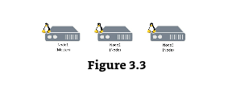
Installing K8S with kubeadm
You can install K8S anywhere using this admin tool. i.e., laptop, bare metal in your data center, even on public clouds.
Kubeadm is the Kubectl for clusters. It is a great tool for building and managing K8S clusters.
We will take 3 nodes by which one having the master and other 2 are worker nodes

Slide 11
High Level Plan
Install Pre-requisites
Initialize the new cluster with node1 as the master
Create the Pod network
Add node2 and node3 as worker nodes
All 3 nodes will get the following :
- Docker - container runtime
- kubeadm – tool to build the cluster
- kubelet – k8s node agent
- kubectl – k8s cli tool

Slide 12
Pre-requisites
Master :
Min 2 GB RAM, 2 CORES of CPU
Slave/Node:
Min 1 GB RAM, 1 CORE of CPU
Now we are going to our master as ‘kmaster’ and slave/node as ‘knode1’ & ‘knode2’
Make sure you switch the user to root to avoid unnecessary issues.
Login into ‘kmaster’, ‘knode1’, ‘knode2’ and execute the below commands
sudo su
apt-get update -y

Slide 13
Update the Hostnames
Run the below command to open the file and rename the master machine to kmaster and node1 machine to knode1 and node2 machine to knode2
vi /etc/hostname
When you open the hostname file, you will already see your private ip address. Delete that and put this “kmaster” in the master instance.
Respectively do the same in knode1 & knode2 as well.
Save the files.

Slide 14
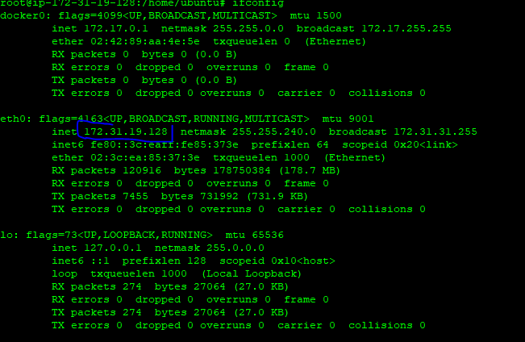
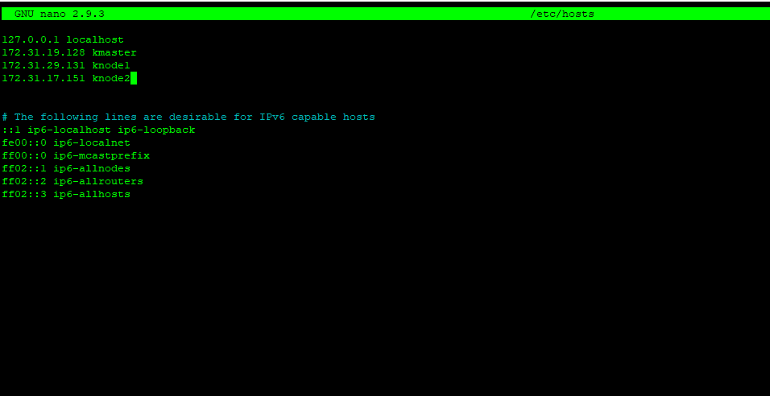
Update the Hosts file with IPS of master and nodes
Run the following command on all 3 machines to note the IP addresses of each
ifconfig
Now go to the “hosts” file on allt he machines
And add the entry.

Slide 15
Install kubeadm, kubelet & kubectl
Above are 3 essential components.
As you guys know, kubelet is the agent which is running on all the nodes.
Kubeadm is used for administrating the Kubernetes cluster.
Kubectl is used for controlling the configurations on various nodes inside the cluster
Run the below command in all the 3 machines.
apt-get update && apt-get install -y apt-transport-https curl
curl -s https://packages.cloud.google.com/apt/doc/apt-key.gpg | apt-key add -
deb http://apt.kubernetes.io/ kubernetes-xenial main
EOF
Apt-get update

Slide 16
Now let’s really install kubeadm, kubelet and kubectl
Please run the below command in all the 3 machines
apt-get install –y kubelet kubeadm kubectl

Slide 17
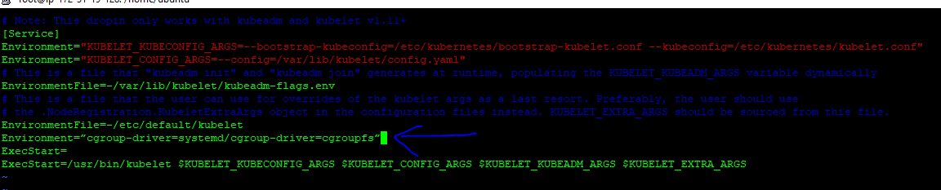
Updating Kubernetes Configuration
Next, we will change the configuration file of K8S. Run the following command in all the 3 machines
vi /etc/systemd/system/kubelet.service.d/10-kubeadm.conf
Then add the marked line above ExecStart=
Environment=”cgroup-driver=systemd/cgroup-driver=cgroupfs”

Slide 18
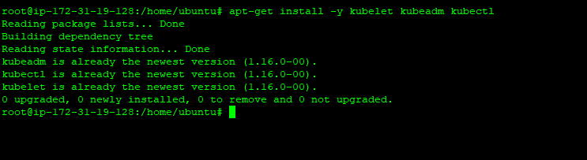
That’s it. You have successfully installed Kubernetes on all the 3 machines now.
If you try to run the below command again, it will tell you that all the components like kubectl, kubelet, kubeadm are installed

Slide 19
Only for kmaster
These steps will only be executed on the master node. i.e., kmaster
Syntax is : # kubeadm init --apiserver-advertise-address=<ip-address-of-kmaster-vm> --pod-network-cidr=x.x.0.0/16
Don’t execute the above command. It’s just a syntax. Execute the below one now in kmaster
# kubeadm init --apiserver-advertise-address=172.31.19.128 --pod-network-cidr=172.31.0.0/16
If you analyse the above command the ip address which I have mentioned is my kmaster private ip address. You have to mention your kmaster private ip address.

Slide 20
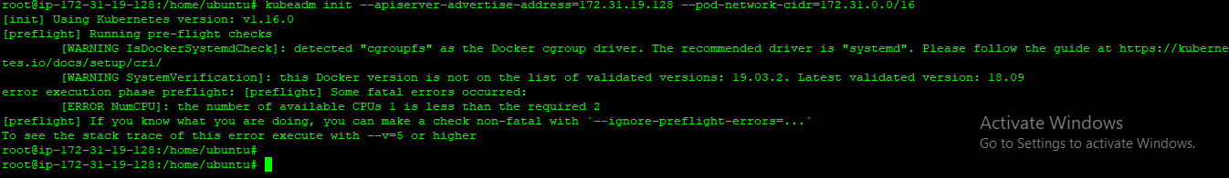
If you get this error, Try to explore the issue

Slide 21
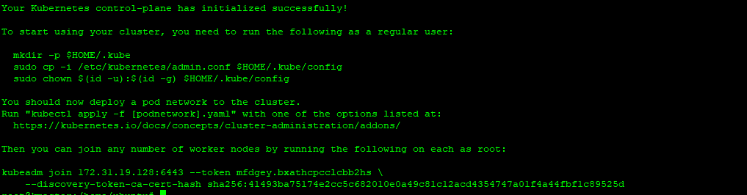
Successfully made the kmaster as Control Plane

Slide 22
What’s next ?
You will get the previous slide output.
To start using your cluster, you need to run the following as a regular user:
mkdir -p $HOME/.kube
sudo cp -i /etc/kubernetes/admin.conf $HOME/.kube/config
sudo chown $(id -u):$(id -g) $HOME/.kube/config
Make sure you run the above 3 commands in kmaster
Once it’s done. Try to run the below commands
Kubectl get nodes
Kubectl get nodes –o wide –-all-namespaces

Slide 23
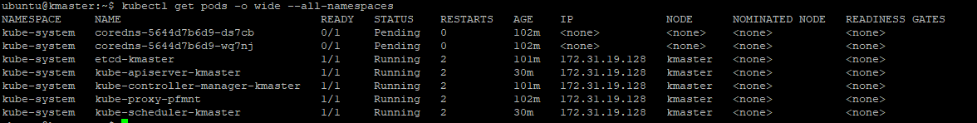
Try the below command
Kubectl get pods –o wide –-all-namespaces
These are the system pods which will be running for backend services. If you see it closely, coredns pods says pending status. Why ? Because we need to create Pod Network which is our next step.

Slide 24
Install a Pod network
If you remember earlier, we ran kubeadm init in our kmaster and we had got some screen and in that screen below command was also present.
You should now deploy a pod network to the cluster.
Run "kubectl apply -f [podnetwork].yaml" with one of the options listed at:
https://kubernetes.io/docs/concepts/cluster-administration/addons/
So we are going to run the command in kmaster again.
But before executing, I would ask you to click the above link and go through various pod networks which is available. We can use any of the networks in our example. I am going to take an example network called “Calico”
Run the below command
kubectl apply -f https://docs.projectcalico.org/v3.9/manifests/calico.yaml

Slide 25
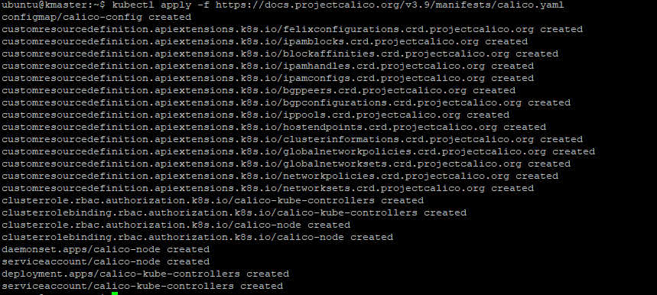
Calico Pod Network Created

Slide 26
Check if the status of the kmaster has changed from NoteReady to Ready
Run the below command to check
Kubectl get nodes
Great, now the CLUSTER is ready
What’s next ?
You have to login to knode1 & knode2 and execute the join command as below
kubeadm join 172.31.9.88:6443 --token 4vwiu4.x2ylvcfb7b2gczg2 --discovery-token-ca-cert-hash sha256:dc308f4b9c25154688393bf467f15b43d4782b08dbccd28456b7ed5c82fd36b3
In your screen, you will have different ip address
Now try to run “kubectl get nodes”
You will see all the 3 nodes

Slide 27
Congtratulations
You have manually built a 3-node cluster using kubeadm

